Slide 1
PoC: Motion Detection & Real-time Monitor- IoT

Slide 2
Requirement/Use case Scenario :
Monitoring the Human activity with PIR/Ultrasonic within the range (default 2feet)
Refresh interval of 1minute & update/log the sensor data to DB/sheets
Will connect to Wi-Fi & can be manageable through remote access
User friendly interface

Slide 3
Software & Hardware requirements:
Software Used:
Arduino IDE
Terminal-for serial Communication
Web browser for remote monitoring
IFTTT portal for DB update & log in Google Spreadsheet
Hardware Used:
NodeMCU/ESP32/ESP8266
Ultrasonic Sensor/PIR
OLED Display
Neopixel

Slide 4
Working:
Once the System boots asks the user to set the range for motion detection & tracking for Ultrasonic Sensor & default value is 60cm if user fails to provide any input.
Once the Range is set, the module connects to Wi-Fi available or opens server for configuring it. Once connected, Network details are sent to the log and monitor is initialized to 0 sec.
If there is any movement within the Specified range the movement time is logged & the time is set on with OLED & terminal displaying object distance & change status.
Once the object remains still , log is updated as object is stationary & if movement detected updated as moving , & if the sensor value goes Out of range the log will be updated as movement ended with time.

Slide 5
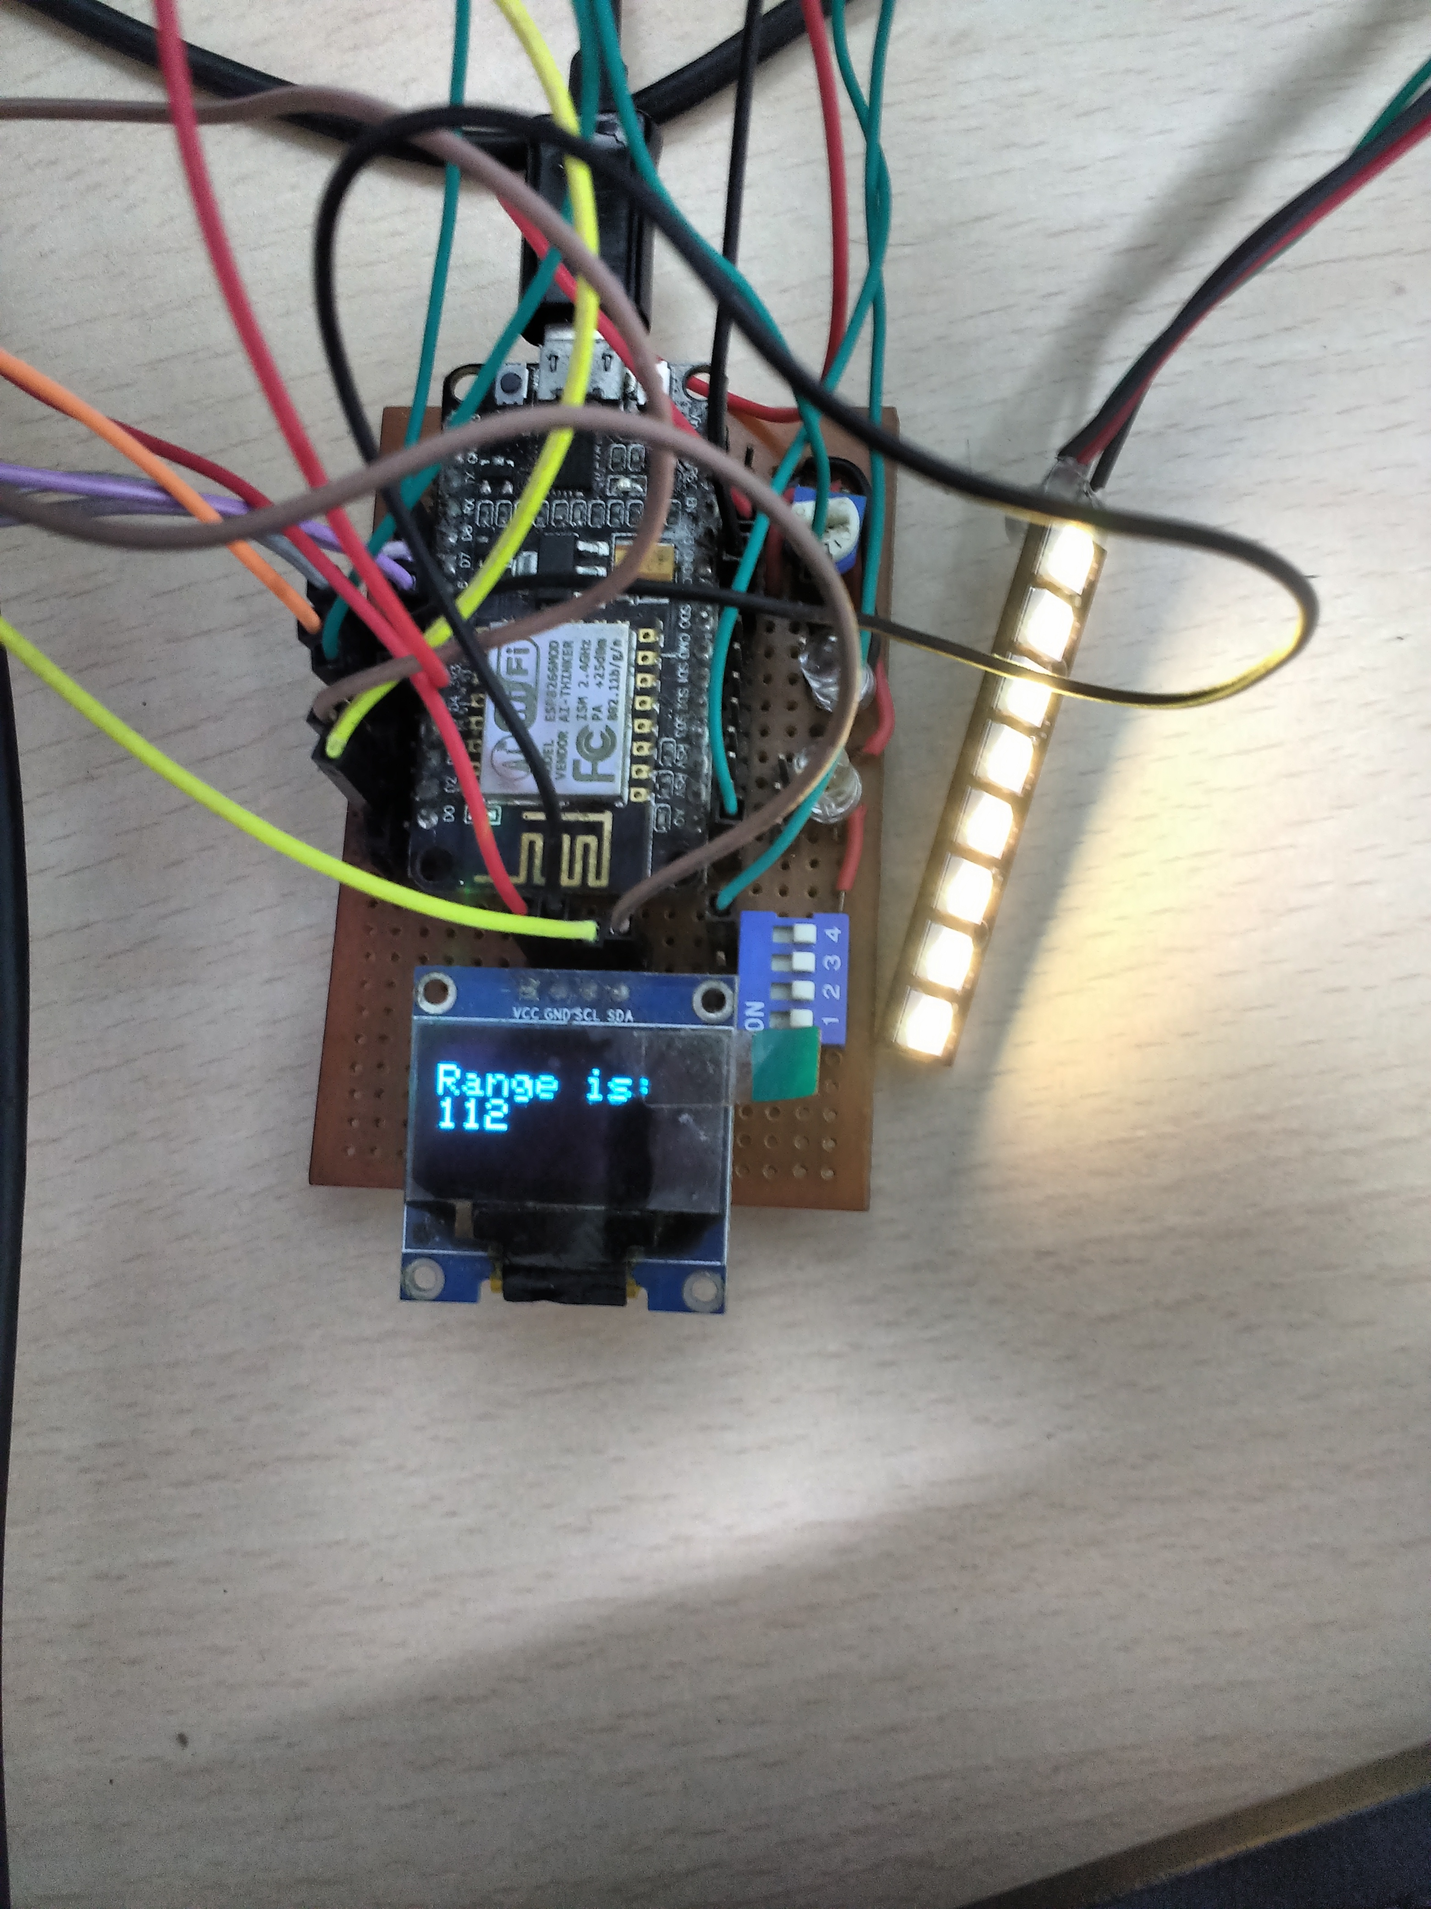
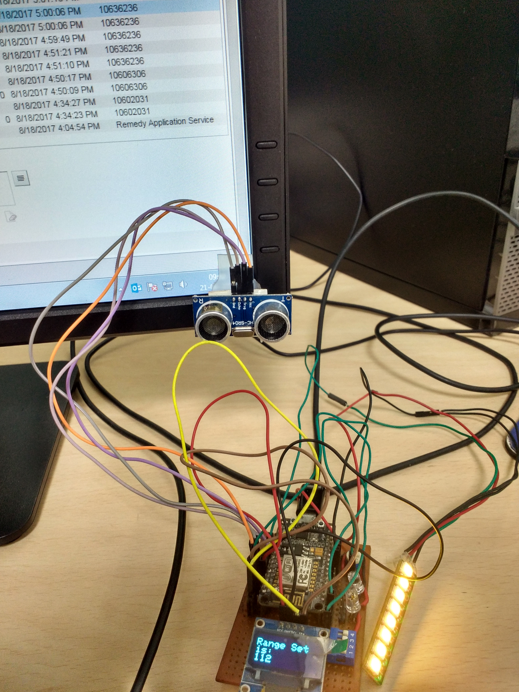
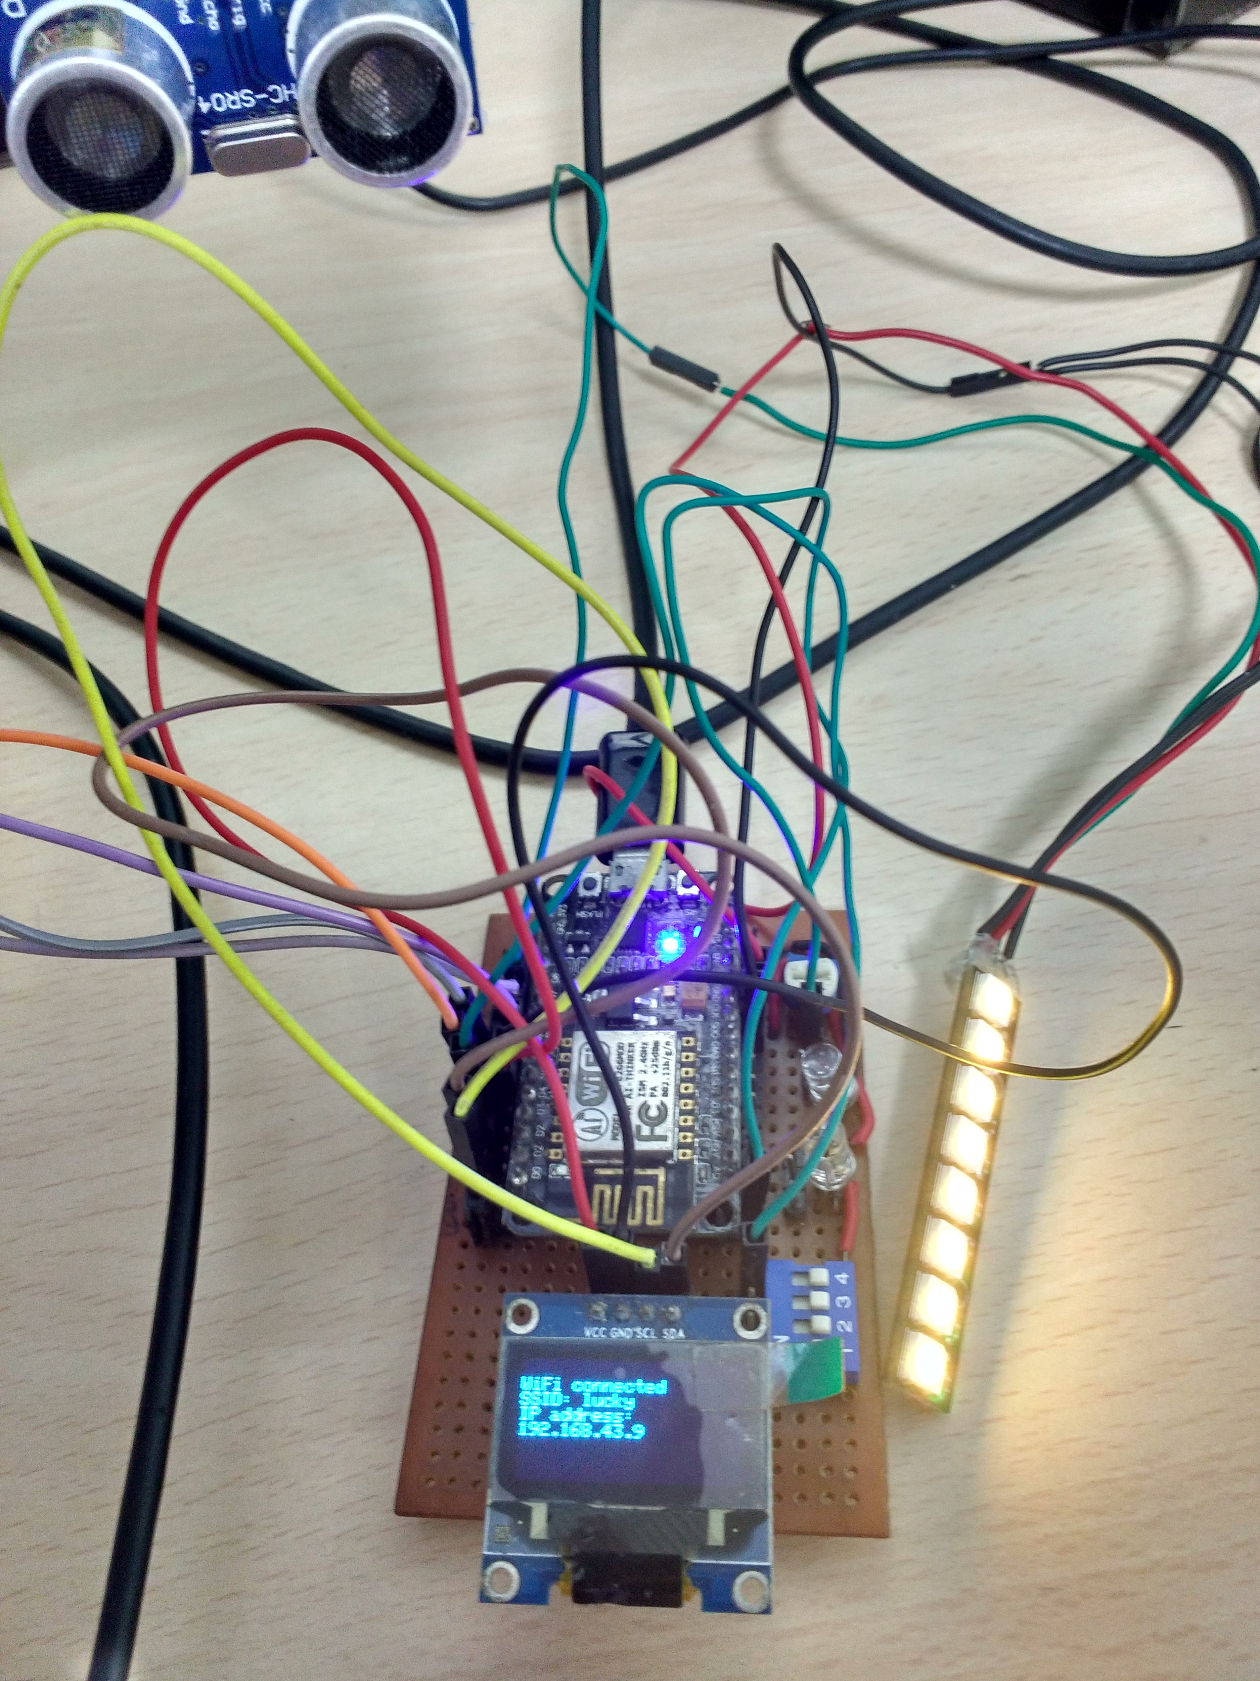
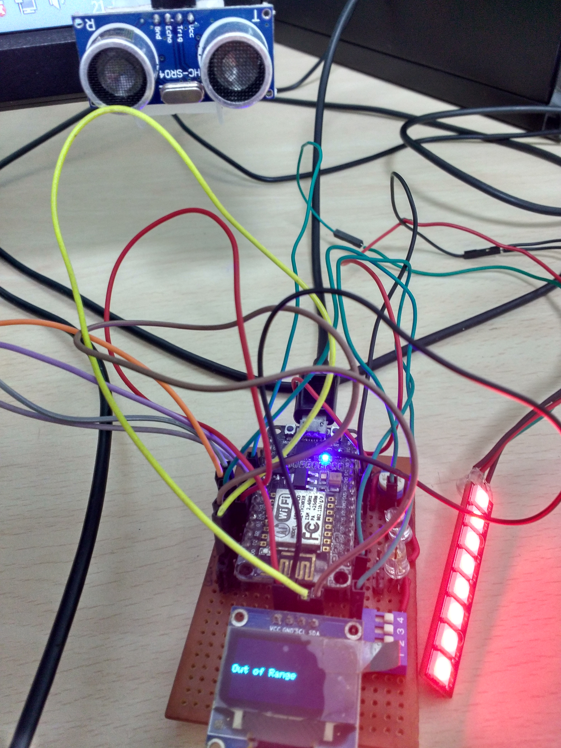
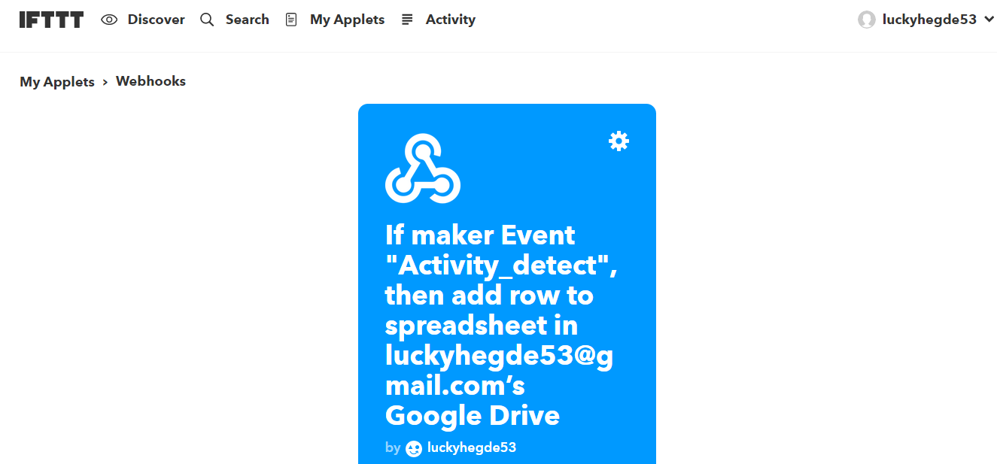
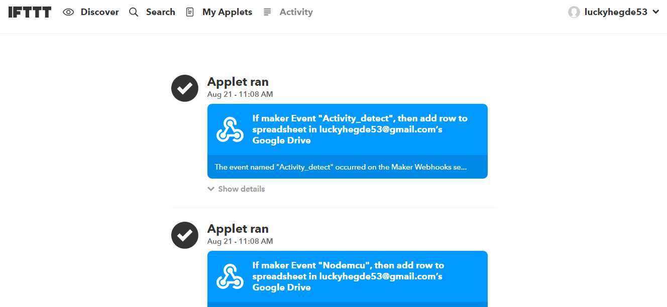
Working:

Slide 6
Useful Links:
Project at GitHub : https://github.com/luckyhegde/IoT_motionDetect
Sensor Test Demo: https://drive.google.com/file/d/1ocgOogTmNW1jOErWXhXUah6JZIyoyKF_JA/view?usp=drivesdk
Google Sheets Live Tracking log: https://docs.google.com/spreadsheets/d/1gLy72Hyv9pIiLP000G9ve50rjXolW3MxVHIkJmcnac/edit?usp=drivesdk
Google Sheets Network log: https://docs.google.com/spreadsheets/d/15ni_hzESHktnZTg3XefFrkcswfWoIqXBWj_Dnj1Mog/edit?usp=drivesdk
Prototype demo: https://www.youtube.com/watch?v=rq0ElHtuAAE&spfreload=10

Slide 7
Demo:

Slide 8
Thank You ☺ Laxmish Hegde 10618850

